Slide 1
Graphs

Slide 2
Set- up
Create a JFrame with a tabbed pane
Load your library
jfreechart-1.5.0.jar
Write your chart methods
Call them from the constructor if you want them viewable at run time

Slide 3
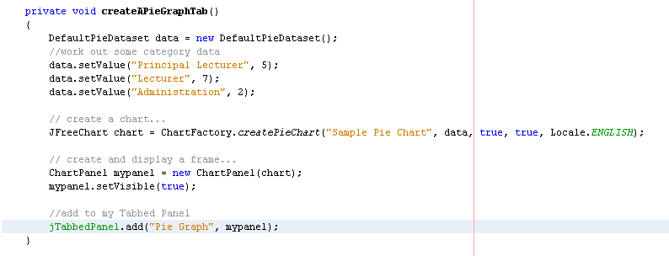
In your assignment this must not be hard coded

Slide 4
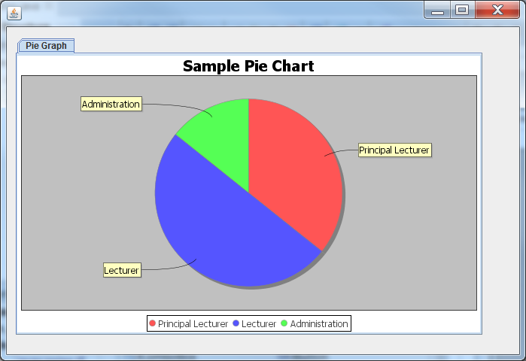

Slide 5
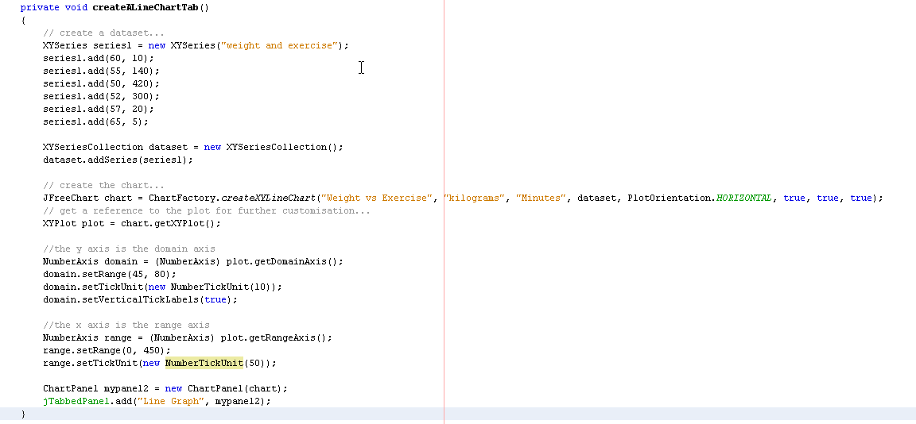
In your assignment this must not be hard coded

Slide 6
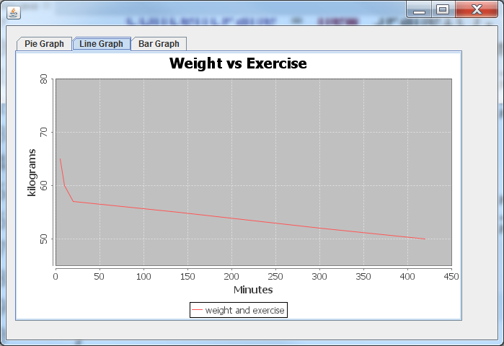

Slide 7
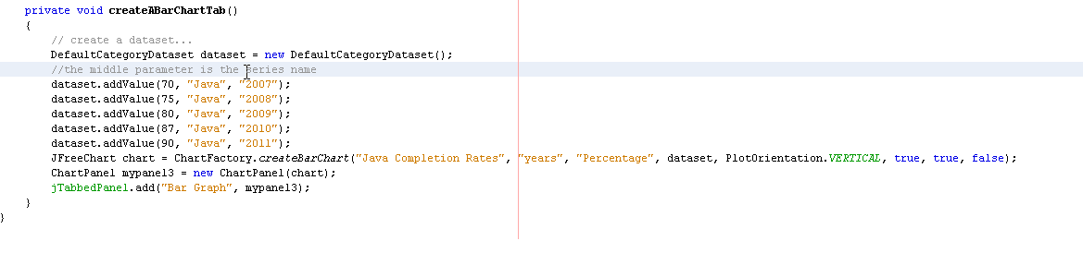
In your assignment this must not be hard coded

Slide 8
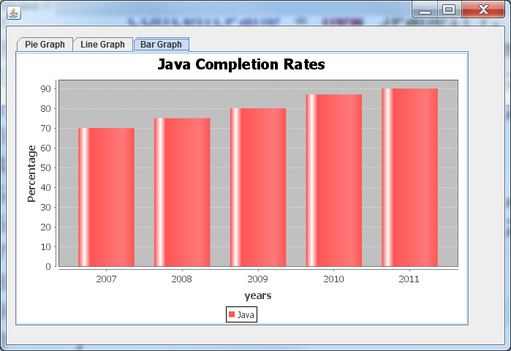

Slide 9
Resources
http://www.jfree.org/jfreechart/api/javadoc/index.html
http://www.jfree.org/jfreechart/api/javadoc/org/jfree/chart/ChartFactory.html
http://zetcode.com/java/jfreechart/

